Slide 1
Investigating The Global Housing Crisis
Chiara Adjoh-Davoh

Slide 2
Introduction
Columns
Source
Country | Categorical
Year | Numerical, Integer
House Price Index | Numerical, Float
Rent Index | Numerical, Float
Affordability Ratio | Numerical, Float
Mortgage Rate (%) | Numerical, Float
Inflation Rate (%) | Numerical, Float
GDP Growth (%) | Numerical, Float
Population Growth (%) | Numerical, Float
Urbanization Rate (%) | Numerical, Float
Construction Index | Numerical, Float
This dataset, originally titled “Global Housing Market Analysis (2015-2024)”, has 11 columns and 200 rows and provides information regarding housing data for the past decade in various countries.
Objective
The purpose of this analysis is to visualize how housing prices, aligned with other economic statistics, have fluctuated and influenced one another, to better understand the ongoing housing crisis in many parts of the world.

Slide 3
Cleaning and Wrangling
Column Wrangling
Firstly, the ”Year” column was left as an integer because year may be useful in numerical analysis in the future.
Secondly, to clarify its purpose, I changed the name of two columns.
Affordability Ratio -> Price to Income Ratio
Urbanization Rate (%) -> Urbanization (%)
Next, “Construction Index” was dropped entirely. Its purpose was not clear and was not specified by the creator of the dataset.
Cleaning
This dataset has 200 rows and 11 columns. None of the rows contain empty or null data. None of the rows are duplicate rows. The describe() function was used to check for values like negative mortgage rates and other illogical values but none were found.

Slide 4
Cleaning and Wrangling
Column Wrangling Continued
Next, two columns were added to provide necessary context and useful information for future analysis.
Firstly, a categorical column titled “Region” assigns a geographical region to each data point based on its country, ex: Japan -> Asia. This grouping will be helpful later.
Secondly, a numerical column titled “Rent to Income Ratio” was created by taking “Price to Income Ratio”, dividing by the “House Price Index” and multiplying by the “Rent Index”. This additional column adds another layer of important information regarding affordability.

Slide 5
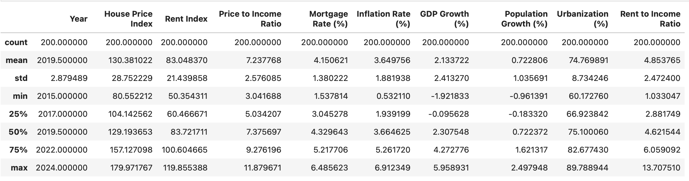
Exploratory Analysis
Summary Statistics
For the first part of the analysis, I used the describe() function to look at and interpret some key statistics.
Items of note:
Range difference between P2I and R2I: Housing prices more stable
Std / Mean of Inflation Rate & GDP: Pandemic
IQR Differences: More data clustered in lower range

Slide 6
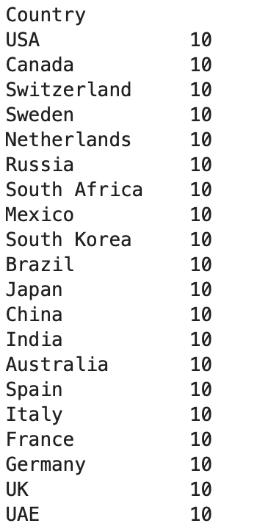
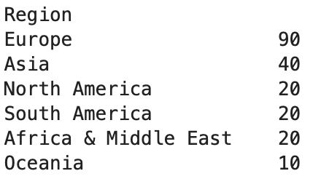
Exploratory Analysis
Counts
Next, I looked at the value counts to see how the data was obtained and where it was obtained from.
When counting by country, there was a perfectly even spread, with each country representing 10 data points, one for each year in the range of 2015-2024.
Counting by region showed a different story, however. There were 90 entries just for Europe. The next most was a huge jump, down to 40. As a result, the data is heavily skewed towards European trends. While this isn’t necessarily a bad thing, its important to note because of how it may influence or conclusions.

Slide 7
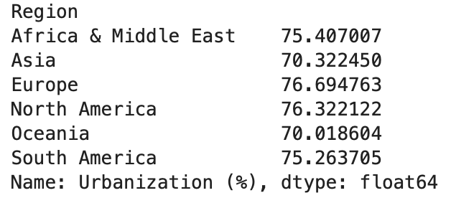
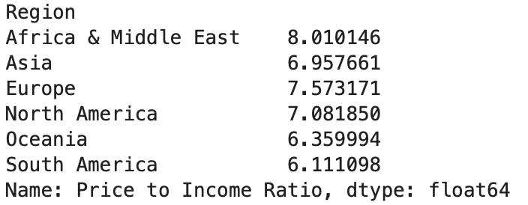
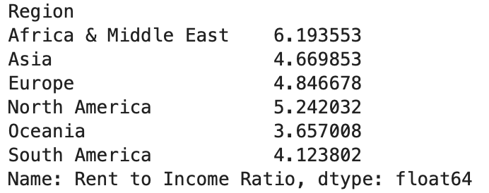
Exploratory Analysis
Regional Statistics
Next, I looked at some stats grouped by region.
Africa and the Middle East had the highest average Price to Income as well as Rent to Income ratios while South America & Oceania had the lowest.
I believe this represents housing disparity and a disconnect between the richest in the area and the average person.
Urbanization is an interesting statistic. When finding the median for each region, Asia was the lowest and Europe was the highest. Asia has a lower Price to Income as well as Rent to Income ratio then Europe. Does this mean Urbanization -> unaffordability?

Slide 8
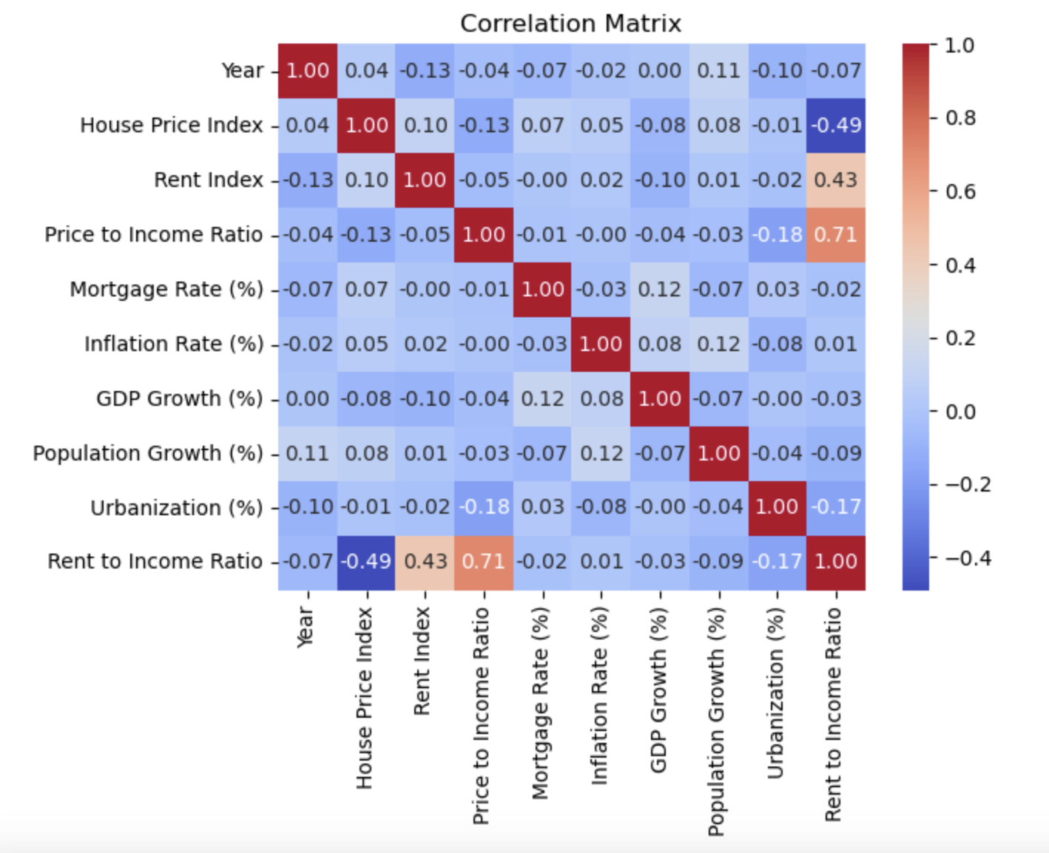
Correlation Matrix
Notable Correlations:
Rent to Income Ratio vs House Price Index (-0.49)
Rent to Income Ratio vs Price to Income Ratio (0.71)
Urbanization vs Price to Income Ratio (-0.18)
Urbanization vs Rent to Income Ratio (-0.17)
Rent Index vs Year (-0.13)
Inflation Rate vs Population Growth (0.12)
While Rent to Income Ratio vs Rent Index have a strong corr., we will disregard it because they are calculated using one another.

Slide 9
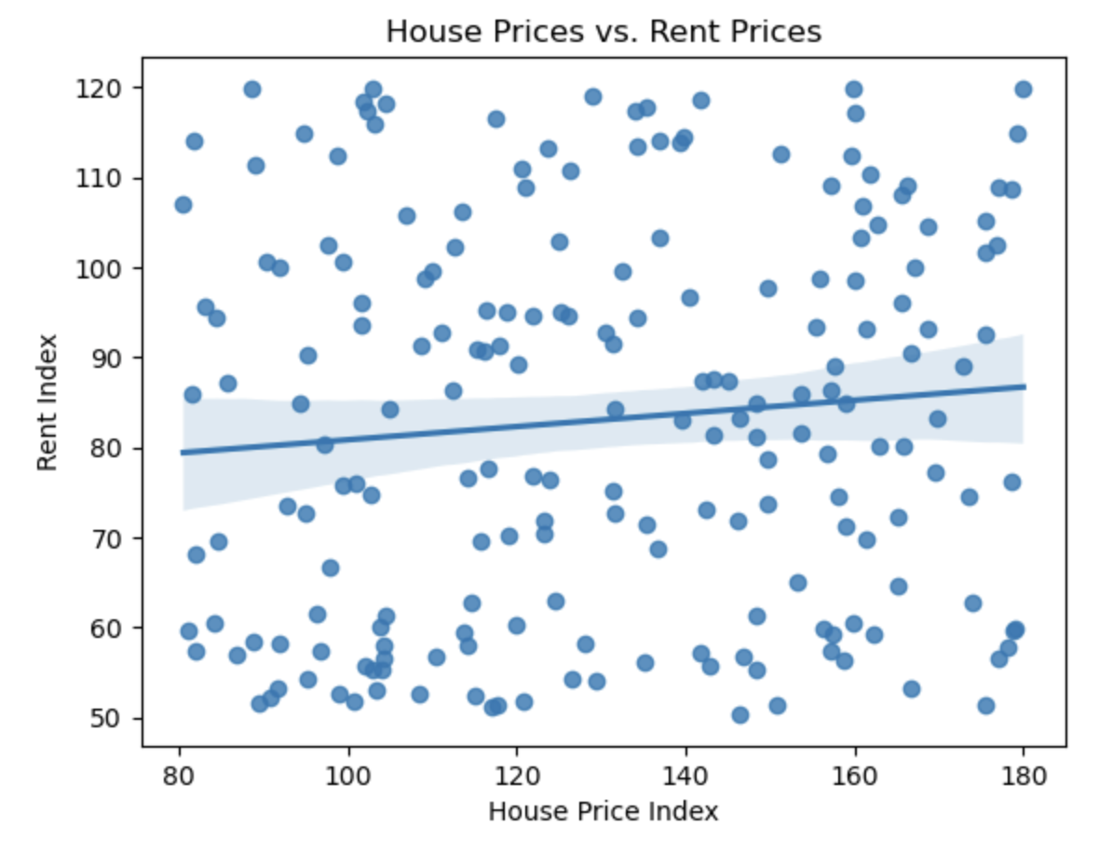
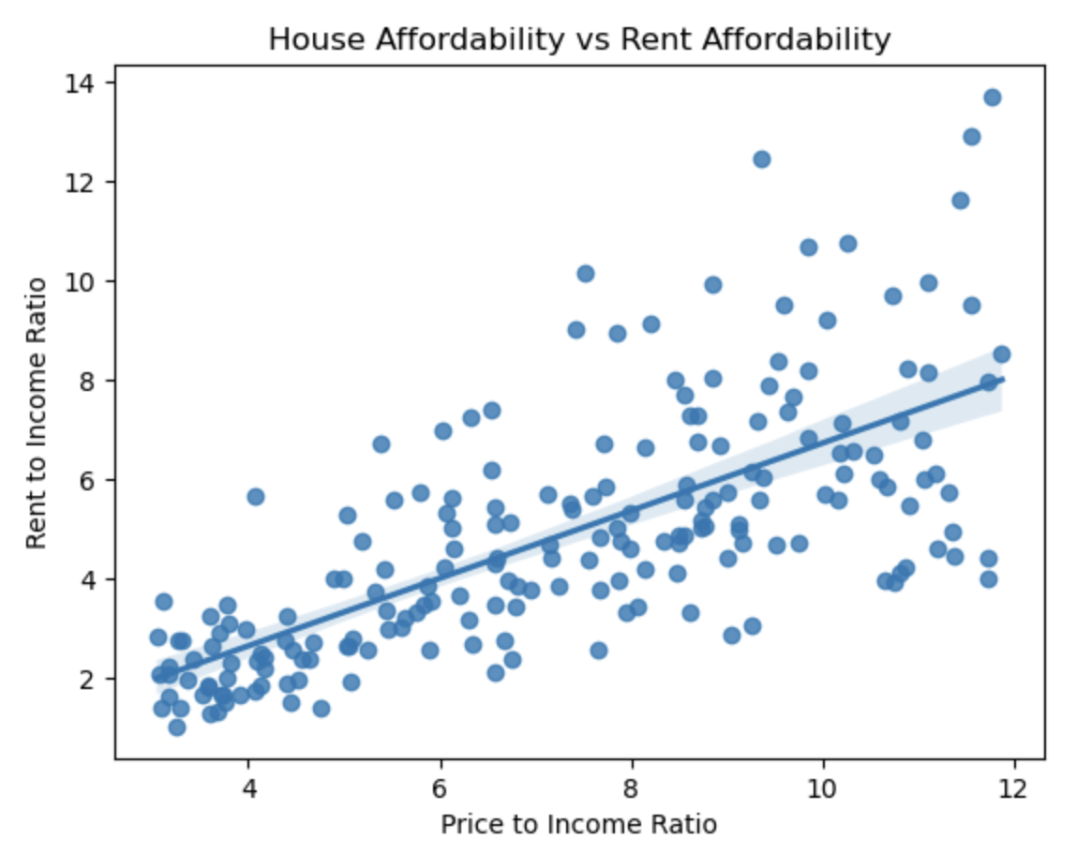
Visualizations
House Prices vs. Rent
No noticeable correlation in the prices themselves however very strong correlation between their affordability. They may not be directly tied but there is a common variable that influences them the same way.

Slide 10
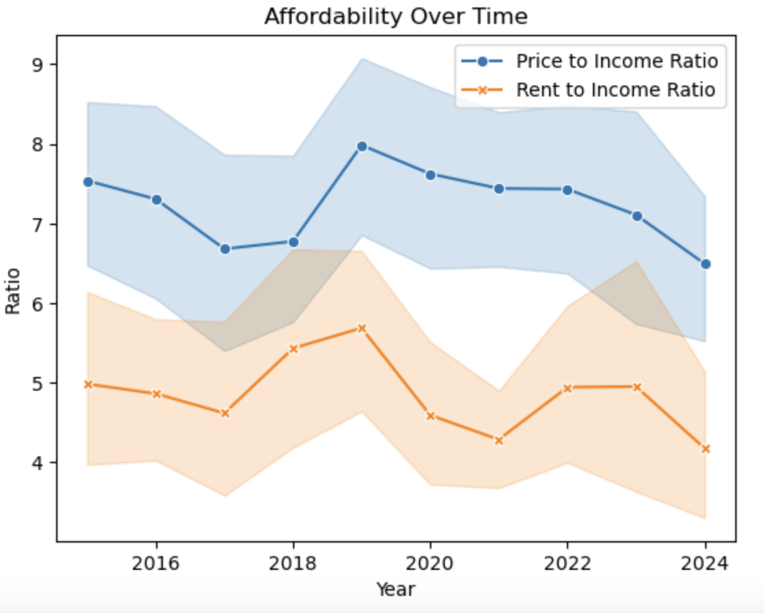
Visualizations
Global Affordability Over Time
While there isn’t a clear long-term trend, there are some interesting peaks and valleys that, coupled with geopolitical knowledge, are very interesting.
Peak mean affordability was in 2019, right before the pandemic tumbled the economy and many lost their jobs.
Affordability is at its minimum in 2024, likely due to the long-term effects of the pandemic.
Housing was on the decline until 2017, when it started to become more affordable.

Slide 11
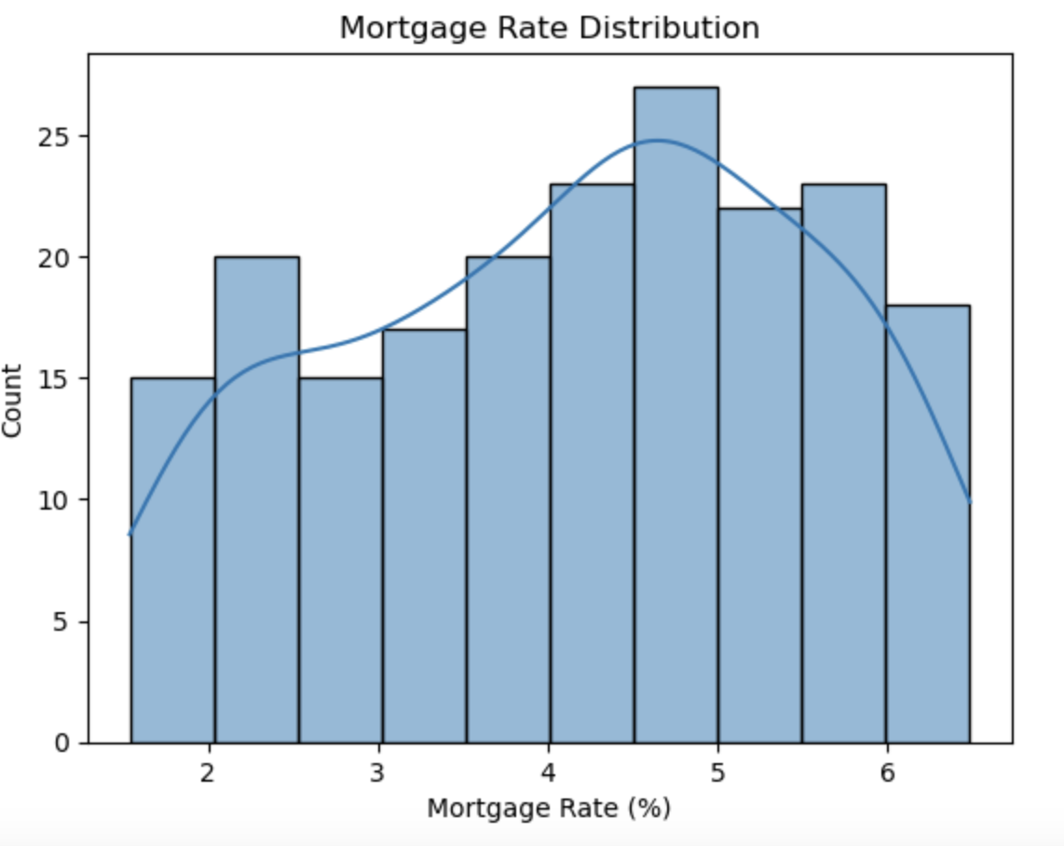
Visualizations
Mortgage Rate Spread
The histogram has a slight left skew. The range with the highest number of values is the 4.5-5% range. Mortgage rates in this range are generally decent, not too expensive but not particularly low either. Middle of the road mortgage rates are a sign of a stable economy.

Slide 12
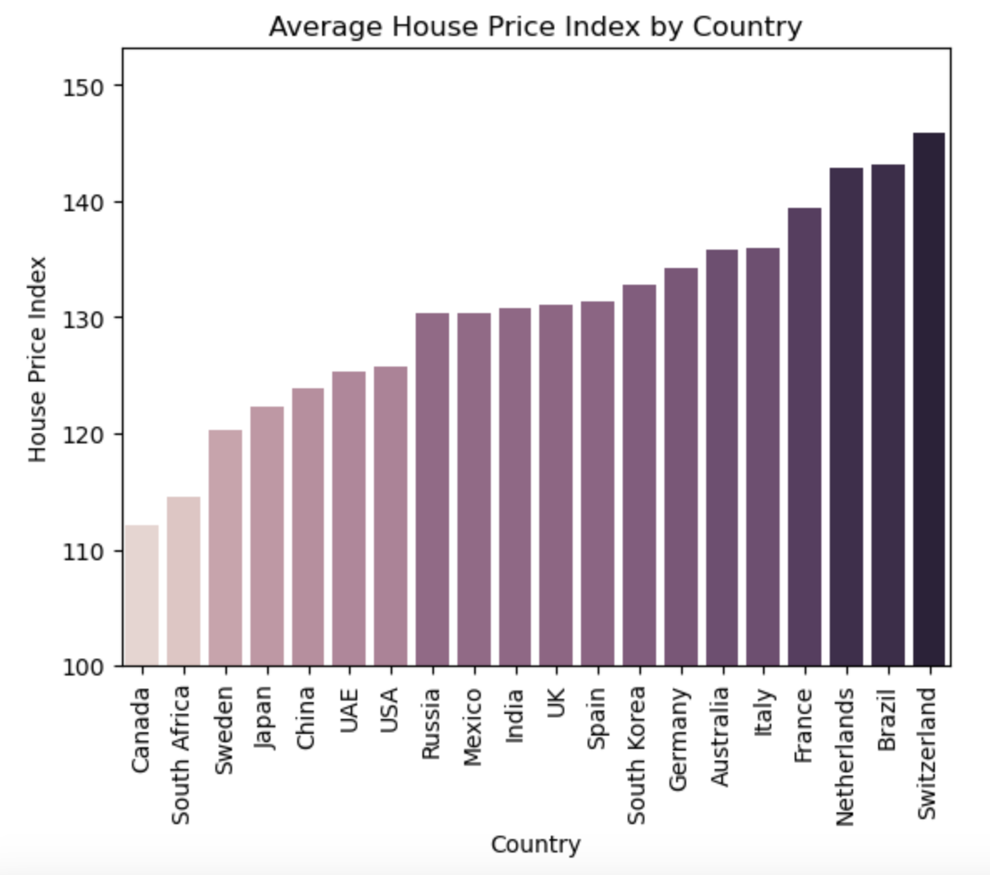
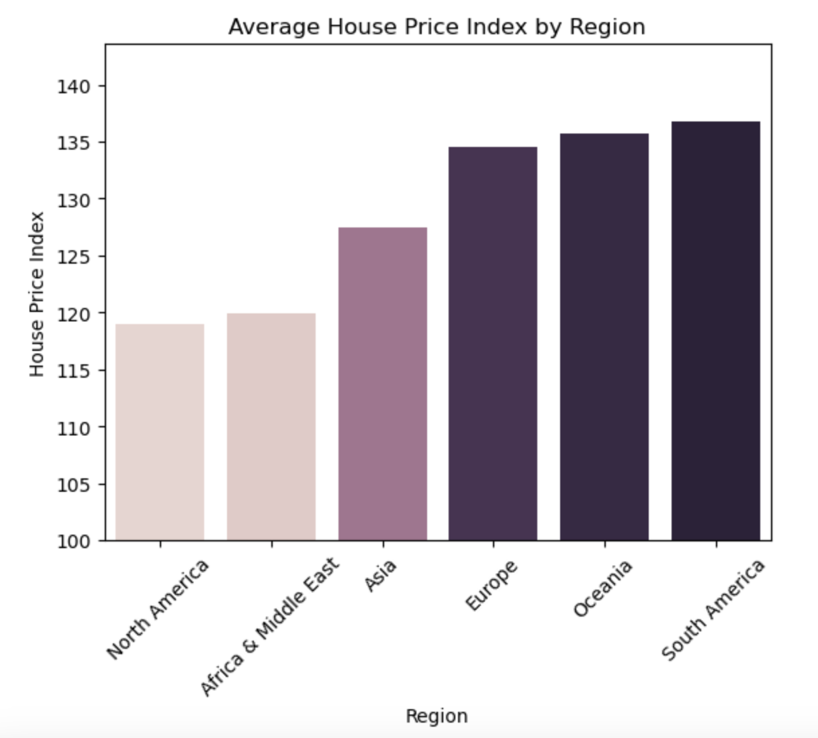
Visualizations
Average House Price Index by Country and Region
The top 5 countries are Italy, France, Netherlands, Brazil and Switzerland (4/5 European) but the top region is South America. Less data points -> Skew

Slide 13
Conclusions
Summary
Limitations
An analysis of the data reveals strong ties to the economic health of a country or region and the affordability of its housing. While rent and housing costs may move independently of one another, global economic factors drive the rise and fall of both. Additionally, urbanization is a driving force for the rise in prices and unaffordability, as more people in an area contributes to housing shortages and an inability for people to afford the prices. It’s always important to include the context of geopolitical events when considering how the economy fluctuates.
This dataset is limited by the inequality of regions represented. Almost half of the data is taken from European countries, which leaves other regions and their struggles underrepresented.

